Slide 1



Guest Lecture
DEEPAK KUMAR
(M.Sc.-IT,MCP,CCNP,AI,Python,SQL,App)
Expertise in Artificial Intelligence and Networking
Owns a Chat-Bot on Telegram.
Contact : 9467511033

Slide 2
Prior Knowledge

Slide 3
Memory
Data
Data Type
Table
Keys

Slide 4
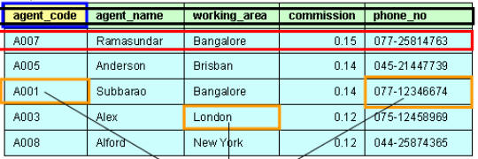

Slide 5
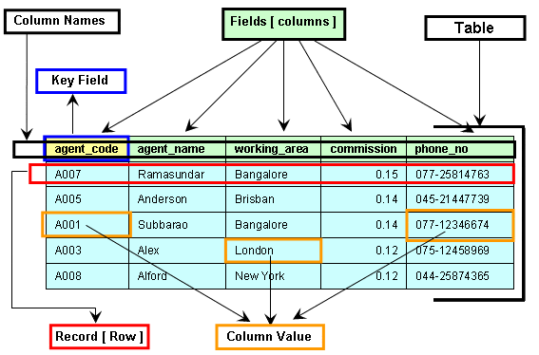

Slide 6
DATA STRUCTURE
Data structure is the way to store and organize the data in the memory so that it can be utilized later in efficient manner.
It is a base for the set of algorithms that we can use in any programming language to structure the data in the memory.

Slide 7
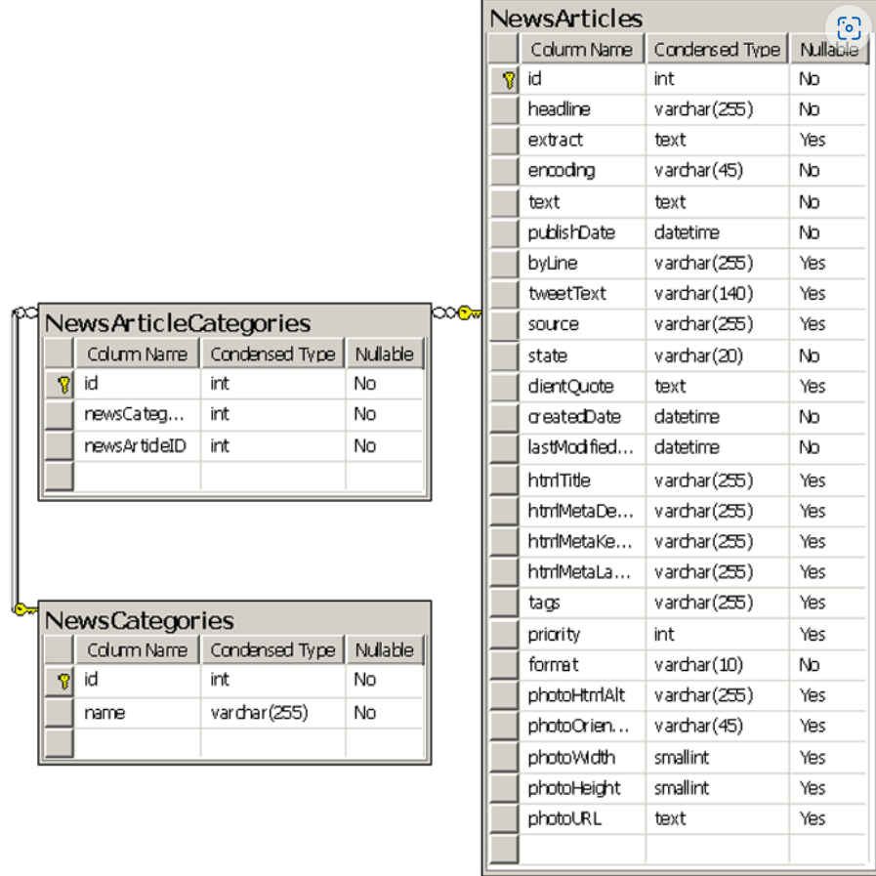

Slide 8
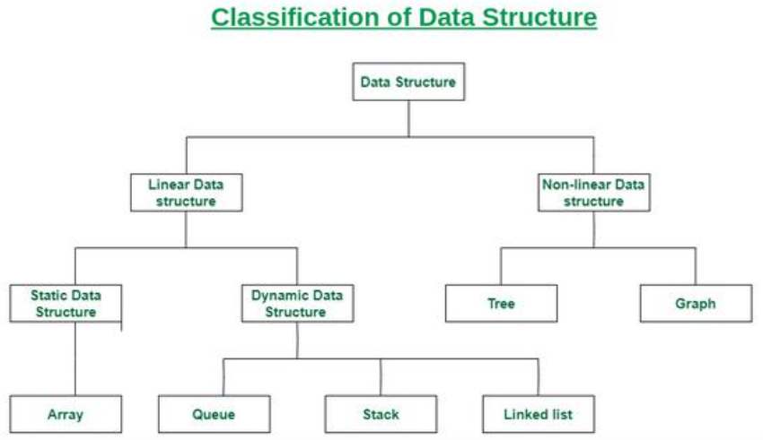

Slide 9


Linear data structure
Data structure in which data elements are arranged sequentially or linearly, where each element is attached to its previous and next adjacent elements, is called a linear data structure.

Slide 10
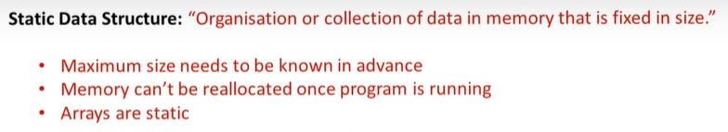
Static data structure: Static data structure has a fixed memory size. It is easier to access the elements in a static data structure.
An example of this data structure is an array.

Slide 11
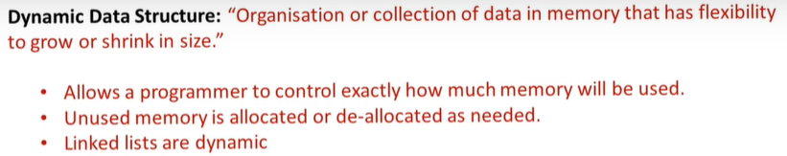
2. Dynamic data structure: In dynamic data structure, the size is not fixed. It can be randomly updated during the runtime which may be considered efficient concerning the memory (space) complexity of the code.

Slide 12
Non-Linear Data Structure:
It is a form of data structure where the data elements don't stay arranged linearly or sequentially. Since the data structure is non-linear, it does not involve a single level. Therefore, a user can't traverse all of its elements in a single run.
In trees, the data elements are arranged in the hierarchical form, whereas
In graphs, the data elements are arranged in random order, using the edges and vertex.

Slide 13
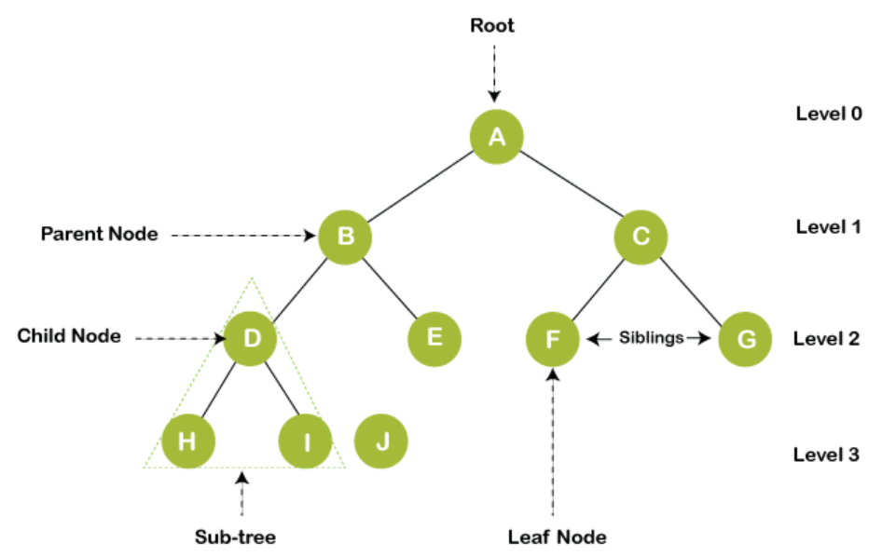

Slide 14


Slide 15


